Slide 1
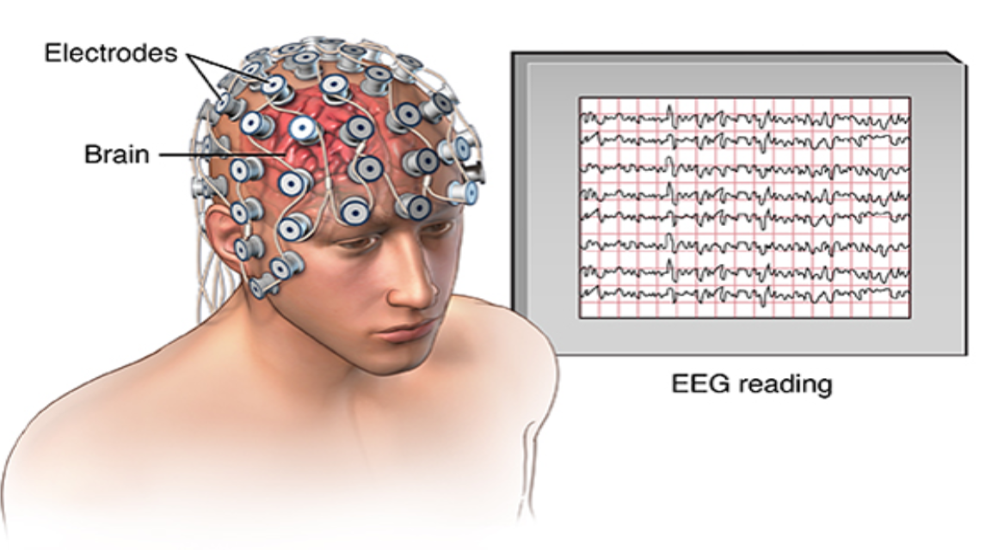
Deep-Learning based Classification of Executed and Imagined Motor Movement EEG Signals
(Pre) Final Project Presentation of the courcse Advanced Topics in Machine Learning (ATML)
-Prof. Favaro-
Members: Özhan Özen, Joaquin Penalver-Andres, Tim Fischer
[http://sipl.eelabs.technion.ac.il/projects/examination-of-tms-effect-using-eeg-signal/]

Slide 2
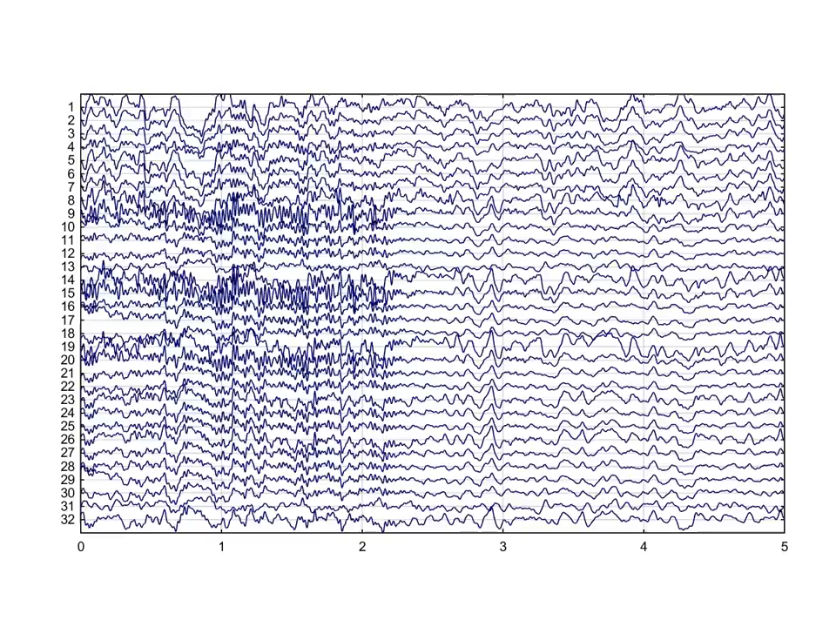
What is an EEG?
Representation of an electrical voltage curve in time.
Most important variables for describing an EEG curve: Amplitude and Frequency
Non-invasive and cost-effective method for direct measurement of electrical brain activity
Advantage: High temporal resolution
Disadvantage: Relatively low spatial resolution

Slide 3
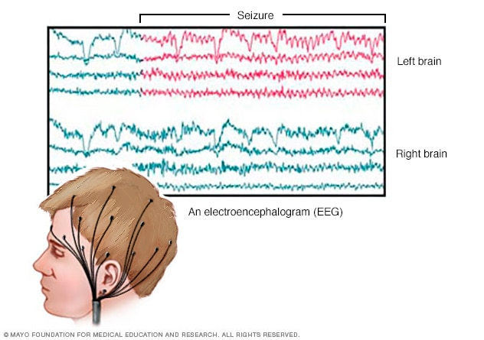
Why do we record an EEG?
Diagnose of brain related diseases
Identifaction of mal functioning areas
Level of brain function (e.g. coma)
BMI: Applications in prosthetics

Slide 4
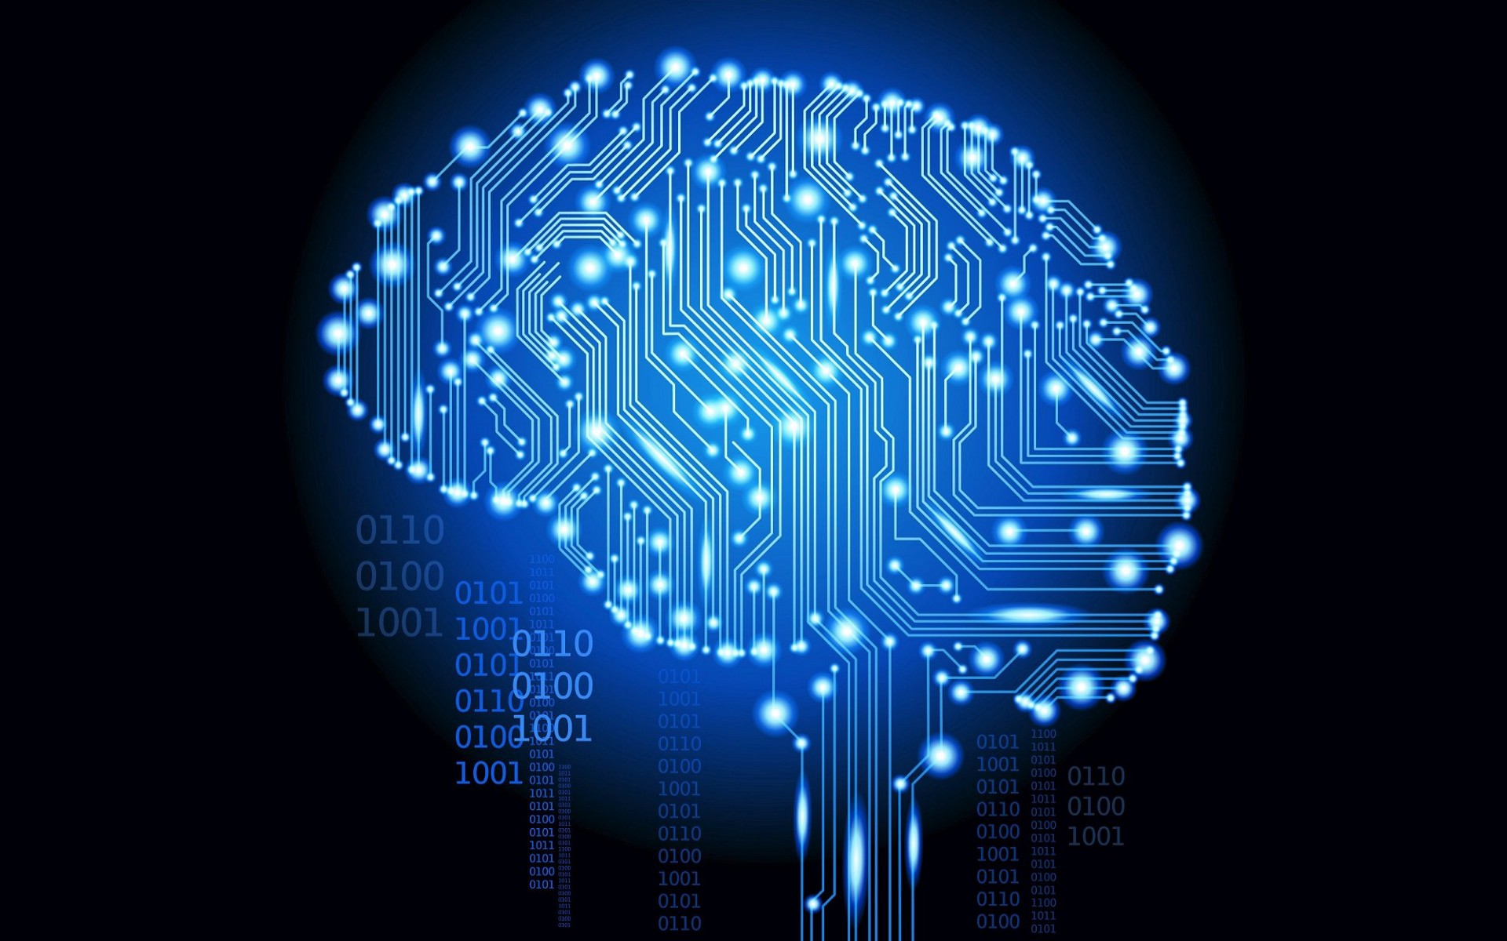
Why Deep Learning?
Standard approaches are domain specific
Highly trained personal
Preprocessing
Inter subject variability
64 Channels -> Huge amount of data
DL very successfull on image text and audio signals

Slide 5

Difficulties
Characteristics of the EEG Signal
Low SNR
Limited Data available + Collection is difficult
Not as many competitions and contributors as in CV
Inter subject variability (+ quality of measurements)
Images vs Time Series from 3D scalp surface
=> Hot Research Topic!
https://www.gdconf.com/news/get-valves-perspective-future-brain-computer-interfaces-gdc-2019
Notes:
The EEG signal has characteristics that make it different
from inputs that ConvNets have been most successful on,
namely images. In contrast to two-dimensional static
images, the EEG signal is a dynamic time series from electrode
measurements obtained on the three-dimensional
scalp surface. Also, the EEG signal has a comparatively
low signal-to-noise ratio, that is, sources that have no taskrelevant
information often affect the EEG signal more
strongly than the task-relevant sources

Slide 6
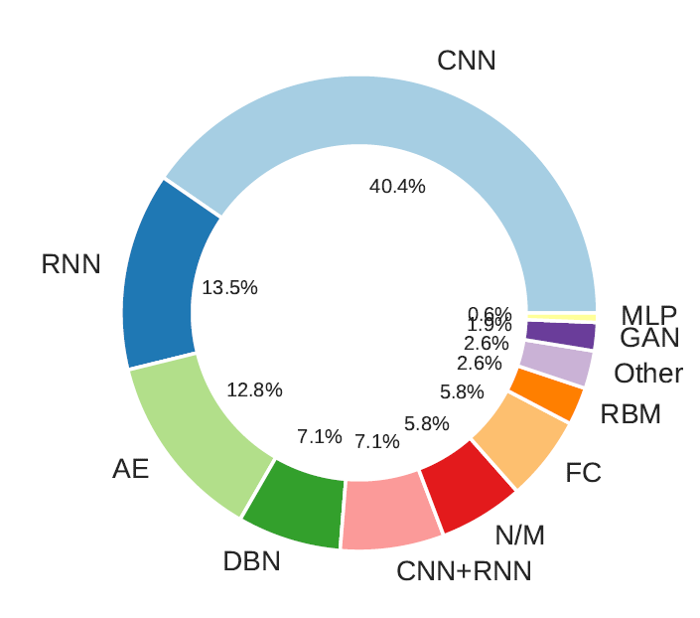
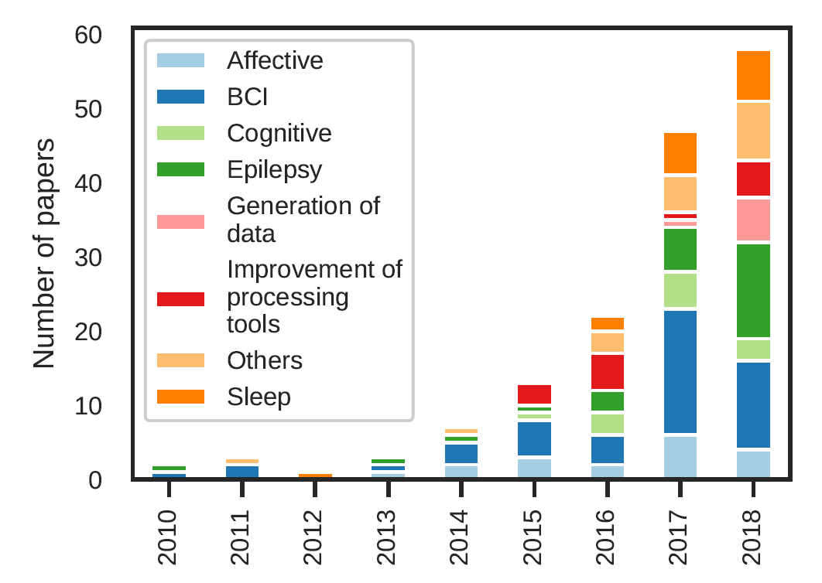
Literature
[Roy, Yannick et al. 2019. “Deep Learning-Based Electroencephalography Analysis: A Systematic Review.”]
Notes:
there is clearly a growing interest in the field. Fig. 5 shows the growth of the DL-EEG
literature since 2010. The first seven months of 2018 alone count more publications than 2010 to 2016 combined,
hence the relevance of this review

Slide 7
Data
Physionet Dataset: EEG Motor Movement/Imaginery Dataset (bci2000.org)
[Goldberger et al. 2000 PhysioBank, PhysioToolkit, and PhysioNet: Components of a New Research Resource for Complex Physiologic Signals. Circulation 101(23):e215-e220 2000 (June 13)]
Label | Description
0 | Baseline, eyes open
1 | Baseline, eyes closed
2 | Motor execution: Left Hand
3 | Motor execution: Right Hand
4 | Motor imagery: Left Hand
5 | Motor imagery: Right Hand
6 | Motor execution: Both Hands
7 | Motor execution: Both Feet
8 | Motor Im: Both Hands
9 | Motor imagery: Both Feet

Slide 8
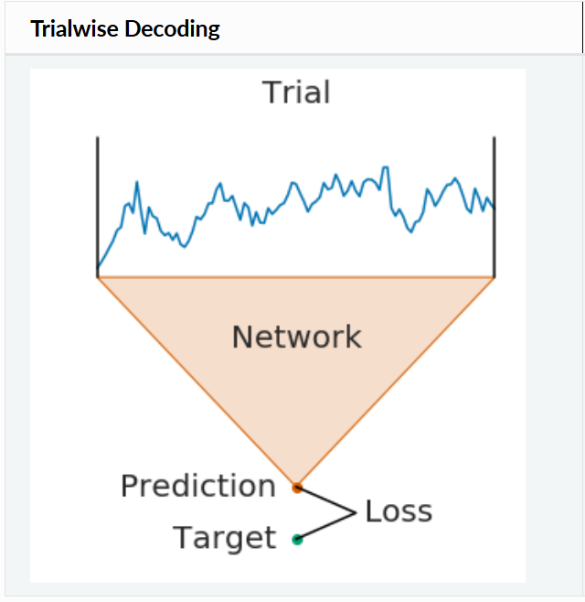
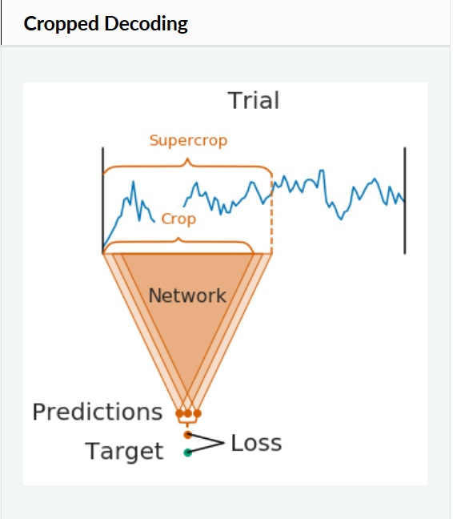
Input Data
Raw EEG Data (normalized -1 to 1), split into trials
Epoch begins 1s before trial and ends 4s after the trial (Experimental) [Roy, Yannick et al. 2019. “Deep Learning-Based Electroencephalography Analysis: A Systematic Review.”]
Cropping increased the performance on the testset

Slide 9
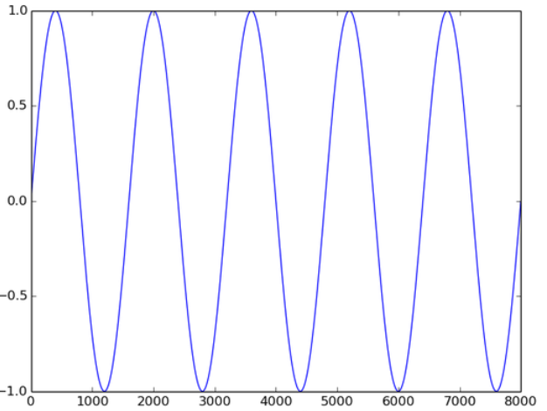
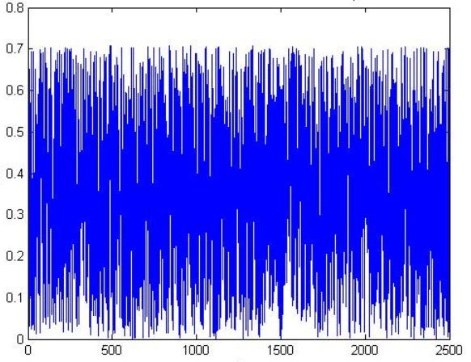
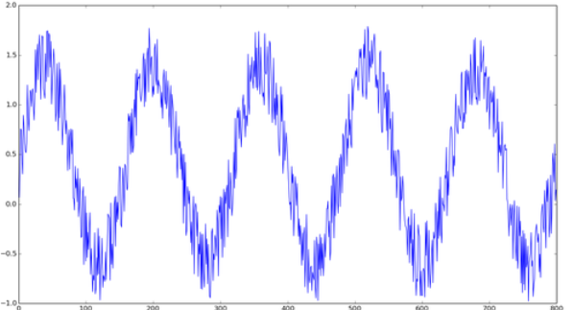
Input Data
Adding white noise to augment the training data*
Generalization
Adding White Noise increased the performance on the testset
+
=
[Wang, Fang et al. 2018. “Data Augmentation for EEG-Based Emotion Recognition with Deep Convolutional Neural Networks.” In , 82–93.]
* 5x increasement of the training data size

Slide 10

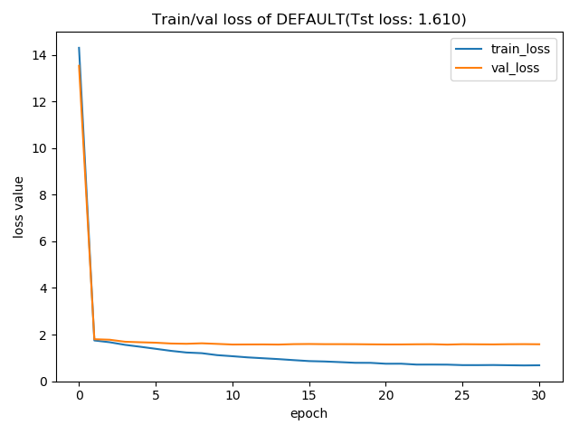

Models … we tried and tried…
Simple FC Models
Deeper and wider FC Models ….
➔ Very low results on the test set + shallow traning curves
Simple, deep and wide combinations of CNNs 1D and 2D
➔Regularization: Dropout … batch normalization …. Weight decay …
Overfitting

Slide 11
Literature and EEG Models
EEGNet, Deep4Net, EEGNetv4 …..
➔ Already way better results than „our“ models!
[Lawhern, Vernon J. et al. 2016. “EEGNet: A Compact Convolutional Network for EEG-Based Brain-Computer Interfaces.”]
[Schirrmeister et al. 2017. “Deep Learning with Convolutional Neural Networks for EEG Decoding and Visualization”]
Train accuracies = Test accuracies ➔ UNDERFITTING
Make it deeper and wider -> No improvement

Slide 12
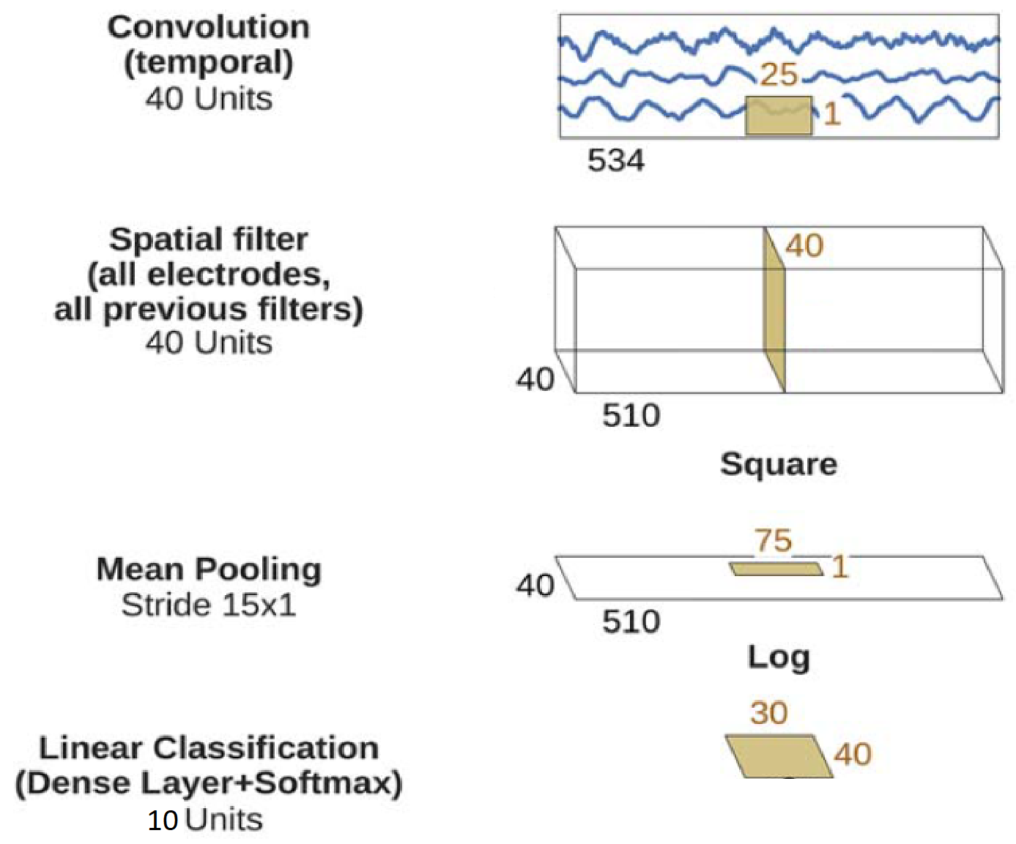
ConvNetFBCSP
# Electrodes
Dropout + ReLu + Batch Normalization
# Electrodes
Dropout + ReLu + Batch Normalization
Class 0 - 9 probabilities
[Schirrmeister et al. 2017. “Deep Learning with Convolutional Neural Networks for EEG Decoding and Visualization”]
Concretely, the first two layers of the shallow
ConvNet perform a temporal convolution and a spatial
filter, as in the deep ConvNet. These steps are analogous
to the bandpass and CSP spatial filter steps in FBCSP. In
contrast to the deep ConvNet, the temporal convolution
of the shallow ConvNet had a larger kernel size (25 vs
10), allowing a larger range of transformations in this
layer (smaller kernel sizes for the shallow ConvNet led to
lower accuracies in preliminary experiments on the training
set). After the temporal convolution and the spatial
filter of the shallow ConvNet, a squaring nonlinearity, a
mean pooling layer and a logarithmic activation function
followed; together these steps are analogous to the trial
log-variance computation in FBCSP (we note that these
steps were not used in the deep ConvNet). In contrast to
FBCSP, the shallow ConvNet embeds all the computational
steps in a single network, and thus all steps can be
optimized jointly (see the section “ConvNet Training”).
Also, due to having several pooling regions within one
trial, the shallow ConvNet can learn a temporal structure
of the band power changes within the trial, which was
shown to help classification in prior work [Sakhavi et al.,
2015].

Slide 13
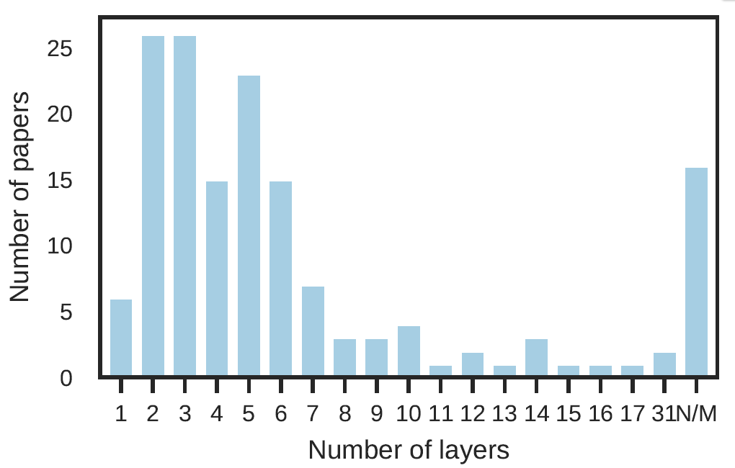
ConvNetFBCSP – Why so shallow?
[Roy, Yannick et al. 2019. “Deep Learning-Based Electroencephalography Analysis: A Systematic Review.”]
Concretely, the first two layers of the shallow
ConvNet perform a temporal convolution and a spatial
filter, as in the deep ConvNet. These steps are analogous
to the bandpass and CSP spatial filter steps in FBCSP. In
contrast to the deep ConvNet, the temporal convolution
of the shallow ConvNet had a larger kernel size (25 vs
10), allowing a larger range of transformations in this
layer (smaller kernel sizes for the shallow ConvNet led to
lower accuracies in preliminary experiments on the training
set). After the temporal convolution and the spatial
filter of the shallow ConvNet, a squaring nonlinearity, a
mean pooling layer and a logarithmic activation function
followed; together these steps are analogous to the trial
log-variance computation in FBCSP (we note that these
steps were not used in the deep ConvNet). In contrast to
FBCSP, the shallow ConvNet embeds all the computational
steps in a single network, and thus all steps can be
optimized jointly (see the section “ConvNet Training”).
Also, due to having several pooling regions within one
trial, the shallow ConvNet can learn a temporal structure
of the band power changes within the trial, which was
shown to help classification in prior work [Sakhavi et al.,
2015].

Slide 14
ConvNetFBCSP*
Filtering in the frequency domain is equivalent to convolution in the time domain.
Whats the characteristics?
Mimiques Bandpasses and CSP filter steps for each bandpass
Select discriminative pairs of frequency bands and corresponding CSP features
Several Pooling Regions within one trial
Learns temporal structure of the band power changes
[Sakhavi S, Guan C, Yan S. (2015): Parallel convolutional-linearneural network for motor imagery classification. In 2015 23rd European Signal Processing Conference (EUSIPCO), IEEE, 2736–40]
*FBCSP = Filter Bank Common Spatial Pattern => Selects the best CSP Features.
CSP = CSP Common spatial pattern (CSP) is a procedure for separating a signal into additive subcomponents which have maximum differences in variance
[Kai Keng et al. 2008. “Filter Bank Common Spatial Pattern (FBCSP) in Brain-Computer Interface.” In 2008 IEEE International Joint Conference on Neural Networks, IEEE, 2390–97.]
Concretely, the first two layers of the shallow
ConvNet perform a temporal convolution and a spatial
filter, as in the deep ConvNet. These steps are analogous
to the bandpass and CSP spatial filter steps in FBCSP. In
contrast to the deep ConvNet, the temporal convolution
of the shallow ConvNet had a larger kernel size (25 vs
10), allowing a larger range of transformations in this
layer (smaller kernel sizes for the shallow ConvNet led to
lower accuracies in preliminary experiments on the training
set). After the temporal convolution and the spatial
filter of the shallow ConvNet, a squaring nonlinearity, a
mean pooling layer and a logarithmic activation function
followed; together these steps are analogous to the trial
log-variance computation in FBCSP (we note that these
steps were not used in the deep ConvNet). In contrast to
FBCSP, the shallow ConvNet embeds all the computational
steps in a single network, and thus all steps can be
optimized jointly (see the section “ConvNet Training”).
Also, due to having several pooling regions within one
trial, the shallow ConvNet can learn a temporal structure
of the band power changes within the trial, which was
shown to help classification in prior work [Sakhavi et al.,
2015].

Slide 15
Overview + (Pre) Final Results
Intensive literature research
+
Applying data augmentation
+
Applying regularization
+
Trying + tweaking our own models
+
Implementing models from papers
+
Tweaking models from papers
Testset overall Accuracy: 51.2144%
Accuracy of class 0 : 25 % of 4 labels Accuracy of class 1 : 0 % of 3 labels Accuracy of class 2 : 60 % of 237 labels Accuracy of class 3 : 54 % of 235 labels Accuracy of class 4 : 50 % of 238 labels Accuracy of class 5 : 52 % of 234 labels Accuracy of class 6 : 48 % of 234 labels Accuracy of class 7 : 56 % of 237 labels Accuracy of class 8 : 37 % of 236 labels Accuracy of class 9 : 50 % of 236 labels
(Train/Val) Test Split: (90/10) /10
Loss: Cross-Entropy Loss
Optimizer : AdamW
Learning Rate Adaption: Cosine Annealing Curve [Loshchilov, Ilya, and Frank Hutter. 2016. “SGDR: Stochastic Gradient Descent with Warm Restarts.”]

Slide 16
Discussion
Regarding results in Computer Vision, poor.
But our problem is more difficult (see „Difficulties“ slide)
No Paper used all subjects (cherry picking) nor all 10 classes (max. 5).
Low SNR
Limited Data available + Collection is difficult
Not as many competitions and contributors as in CV
Inter subject variability (+ quality of measurements)
Images vs Time Series from 3D scalp surface

Slide 17

Future Work
Further Methodologies:
Try light preprocessing of obvious artifacts
Try more data augmentation (changing electrodes for symmetric tasks)
[Deiss,et al. 2018. “HAMLET: Interpretable Human And Machine Co-Learning Technique.”]
Try convert EEG to video and use optical flow
Apply transferlearning on established classifiers
[Tan, Chuanqi, Fuchun Sun, and Wenchang Zhang. 2018. “Deep Transfer Learning for EEG-Based Brain Computer Interface.”]
Make a combination with RNN (or LSTM) network to extract temporal patterns in the frame sequences
[Bashivan et al. 2015. “Learning Representations from EEG with Deep Recurrent-Convolutional Neural Networks.”]
[Zhang, Dalin et al. 2018. “Fuzzy Integral Optimization with Deep Q-Network for EEG-Based Intention Recognition.” In Springer, Cham, 156–68.]

Slide 18
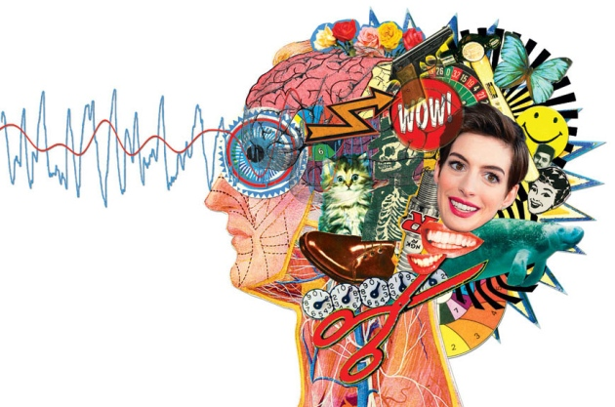
Thank you very much for your attention!
Tim Fischer
tim.fischer@artorg.unibe.ch
Sources:
Siuly, Siuly, Yan Li, and Yanchun Zhang. 2016. EEG Signal Analysis and Classification. Cham: Springer International Publishing.
Lawhern, Vernon J. et al. 2016. “EEGNet: A Compact Convolutional Network for EEG-Based Brain-Computer Interfaces.”
Loshchilov, Ilya, and Frank Hutter. 2016. “SGDR: Stochastic Gradient Descent with Warm Restarts.”
Roy, Yannick et al. 2019. “Deep Learning-Based Electroencephalography Analysis: A Systematic Review” Schirrmeister, Robin Tibor et al. 2017. “Deep Learning with Convolutional Neural Networks for EEG Decoding and Visualization.” Wang, Fang et al. 2018. “Data Augmentation for EEG-- Based Emotion Recognition with Deep Convolutional Neural Networks.” In , 82–93. Sakhavi, Siavash, Cuntai Guan, and Shuicheng Yan. 2015. “Parallel Convolutional-Linear Neural Network for Motor Imagery Classification.” Kai Keng Ang, Zhang Yang Chin, Haihong Zhang, and Cuntai Guan. 2008. “Filter Bank Common Spatial Pattern (FBCSP) in Brain-Computer Interface.” Bashivan, Pouya, Irina Rish, Mohammed Yeasin, and Noel Codella. 2015. “Learning Representations from EEG with Deep Recurrent-Convolutional Neural Networks.” Deiss, Olivier et al. 2018. “HAMLET: Interpretable Human And Machine Co-LEarning Technique.” Tan, Chuanqi, Fuchun Sun, and Wenchang Zhang. 2018. “Deep Transfer Learning for EEG-Based Brain Computer Interface.” Zhang, Dalin et al. 2018. “Fuzzy Integral Optimization with Deep Q-Network for EEG-Based Intention Recognition.” In Springer, Cham, 156–68.

Slide 19
